Slide 1




Telecom Customer Churn Prediction
Presented by:
Name: Sandip Ramcharit Verma
PRN: 20240804044
Dr. Jagadish S Jakati
Project Guide
Dr. Swapnil Waghmare
Project Coordinator
Dr. Maheshwari Biradar
HOD, BCA&MCA

Slide 2

Content
Introduction
Block Diagram
Flowchart
Data Dictionary
Data Preprocessing
Exploratory Data Analysis (EDA)
Model Building
Model Evaluation
Model Deployment
Conclusion

Slide 3

Introduction
Customer churn means when people stop using a telecom company’s services. This causes the company to lose money and work harder to find new customers.
In this project, we use machine learning to look at past customer data and find patterns to predict who might leave.
If the company knows this in advance, it can give better offers or support to keep customers happy and reduce churn.
The main goal is to build a model that is both easy to use and accurate, so telecom companies can keep more customers and improve their service.
Problem Statement:
The aim of the project is to analyze customer demographics, services, tenure, and other variables to predict whether a particular customer will churn or not.
Objective:
Develop a predictive model to identify customers at risk of churning.
Enable telecom companies to take proactive retention measures.

Slide 4
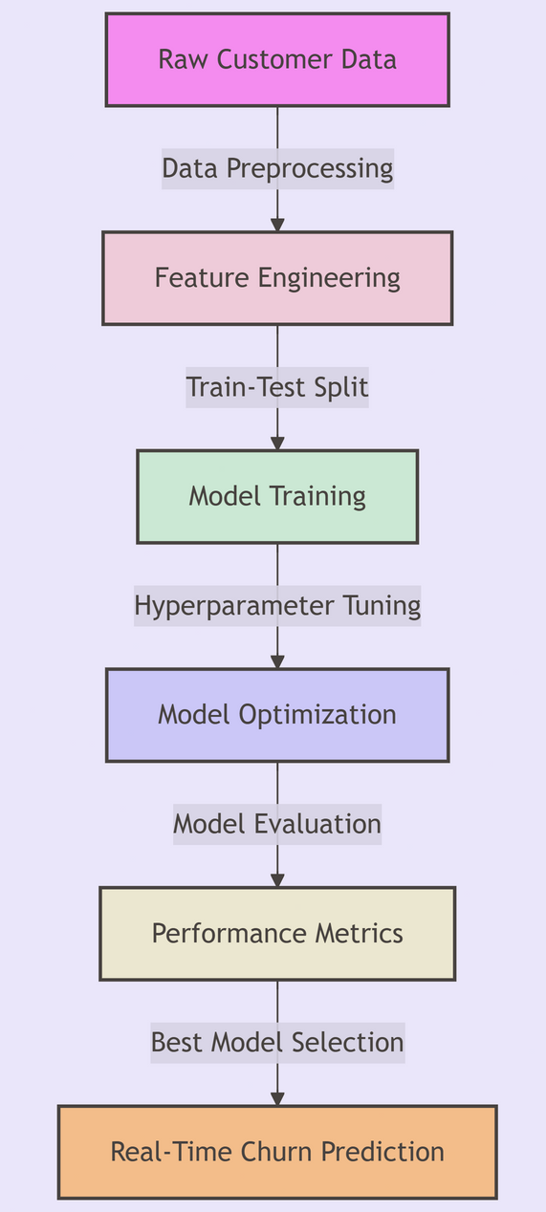
Block Diagram

Slide 5

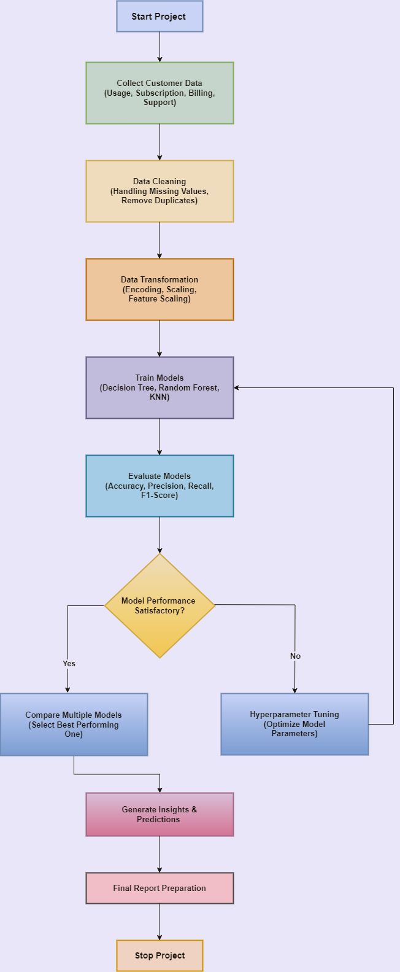
Flowchart
A
A

Slide 6
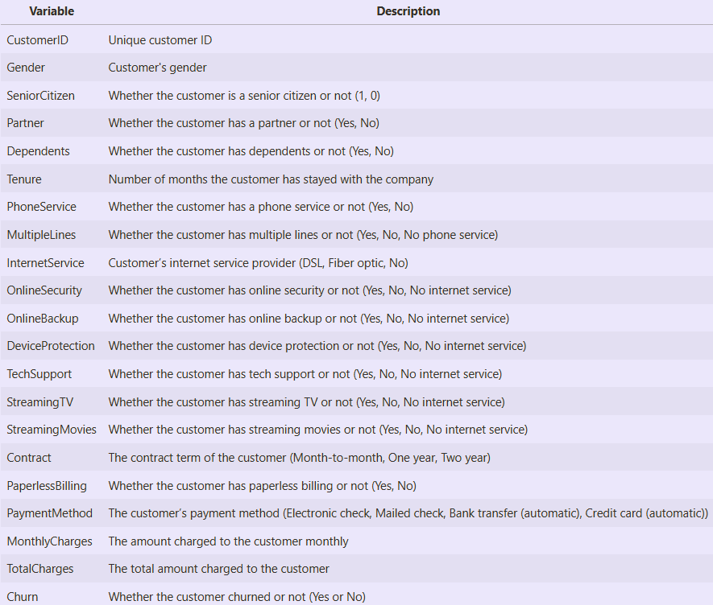
Data Dictionary

Slide 7
Data Preprocessing
Data Cleaning:
Handled missing values.
Removed duplicate entries.
Converted data types where necessary.
Feature Engineering:
Encoded categorical variables using Label Encoding.
Feature Scaling:
Standardized numerical features (e.g., Tenure, MonthlyCharges, TotalCharges) for better model performance.
Outlier Detection:
No significant outliers were found in the dataset.

Slide 8
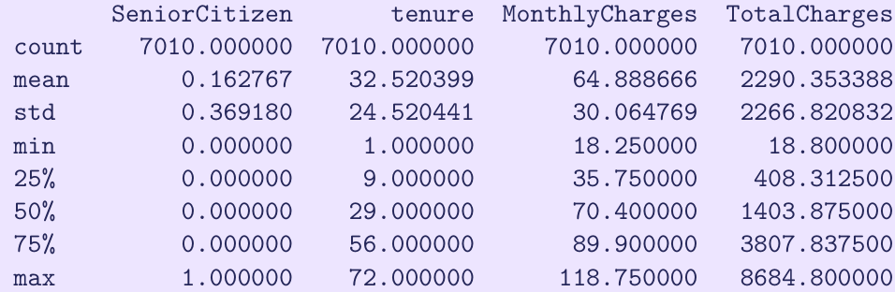
Exploratory Data Analysis (EDA)
Summary Statistics:
A quick look at the numerical features provides insights into the dataset’s structure and spread.
Key Observations:
The tenure ranges from 1 to 72 months, indicating both new and long-term customers.
The MonthlyCharges vary between $18.25 and $118.75, showing different subscription levels.
The TotalCharges column initially had missing values, which were handled earlier.

Slide 9
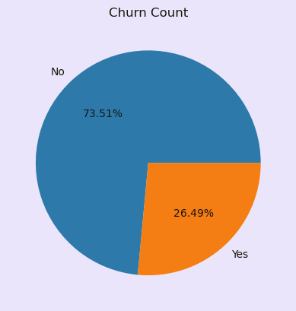
Churn Count:
The number of churning customers is significantly lower compared to non-churning customers.
Only 26.49% of customers have churned from the telecom company.
This indicates the company is effective at retaining its customers.

Slide 10
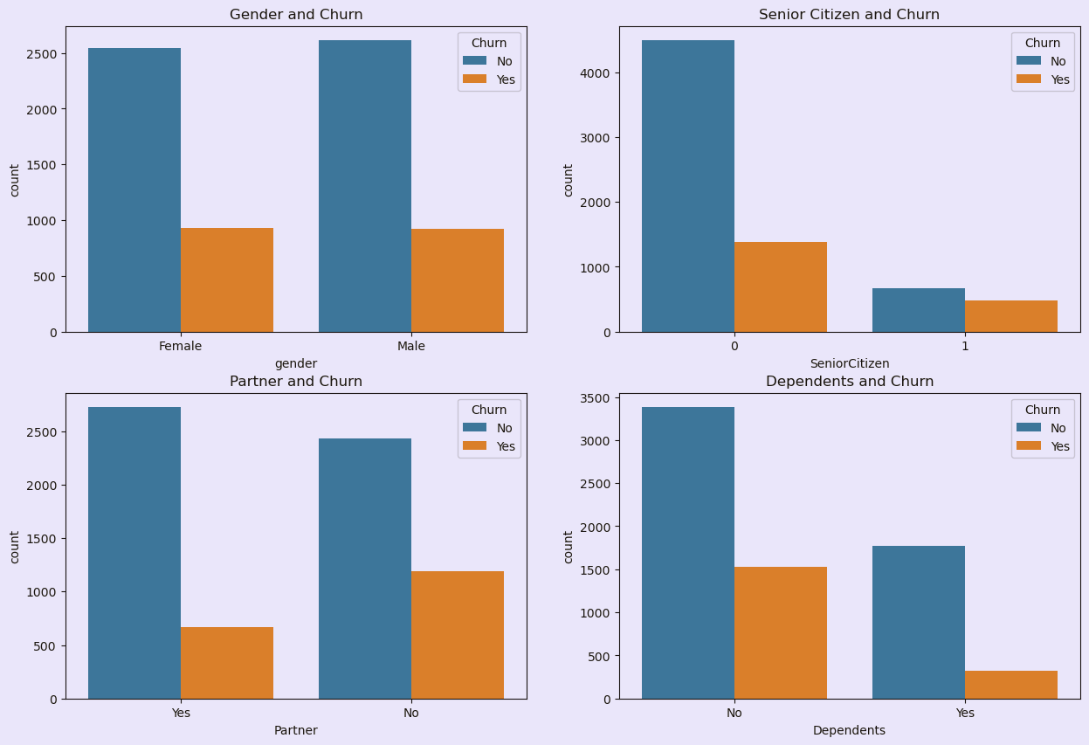
Customer Demographics and Churn
Gender:
Churn count is equal for males and females, indicating no relation between gender and customer churn.
Senior Citizens:
Have lower churn rates compared to non-senior citizens, possibly due to their Unwillingness to switch companies.
No Partners:
Customers without partners show higher churn rates compared to those with partners.
No Dependents:
Customers without dependents also have higher churn rates than those with dependents.
Conclusion:
Single customers with no partners or dependents are more likely to churn, while senior citizens are less likely to leave.

Slide 11
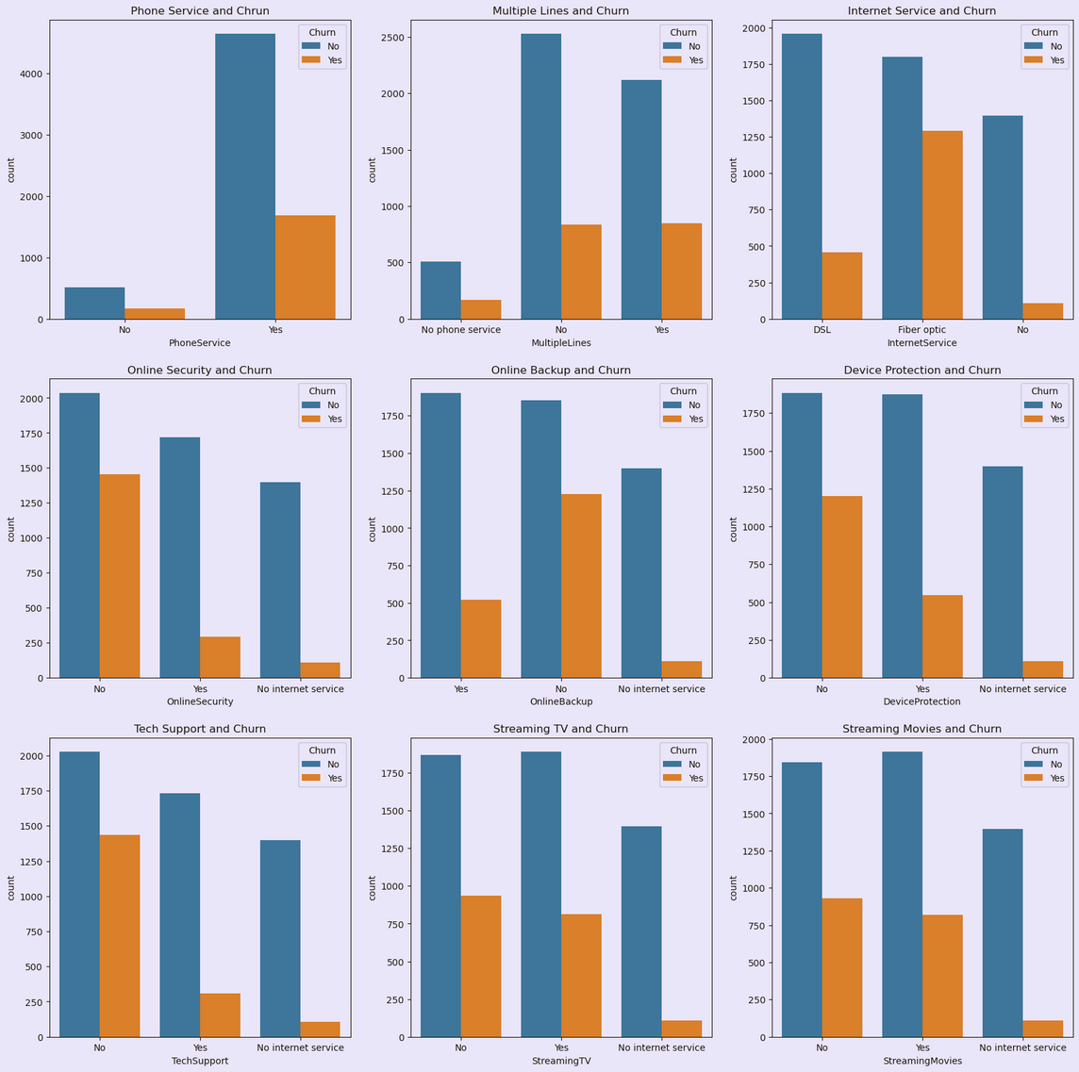
Services and Churn:
Phone and Internet Services:
No relation between churn and service opted, but churn is higher for customers with multiple lines.
Online Backup and Device Protection:
Higher churn count for customers who haven’t opted for these services.
Streaming Services:
Customers with streaming services have lower churn rates.
Conclusion:
Customer churn is influenced by multiple lines, Internet Service, Online Security, Online Backup, Device Protection, Tech Support and Streaming Services.

Slide 12
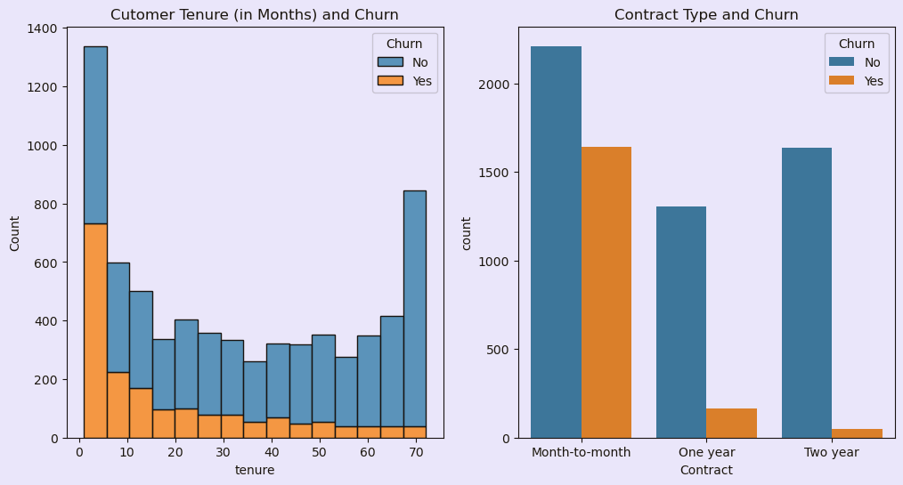
Tenure/Contract and Churn:
Tenure and Churn:
Customers with shorter tenure (less than 5 months) have higher churn count. Churn decreases as tenure increases.
Contract and Churn:
Customers with month-to-month contracts have higher churn rates compared to those with one or two-year contracts.
Conclusion:
Longer contracts and extended tenure correlate with lower churn rates.

Slide 13
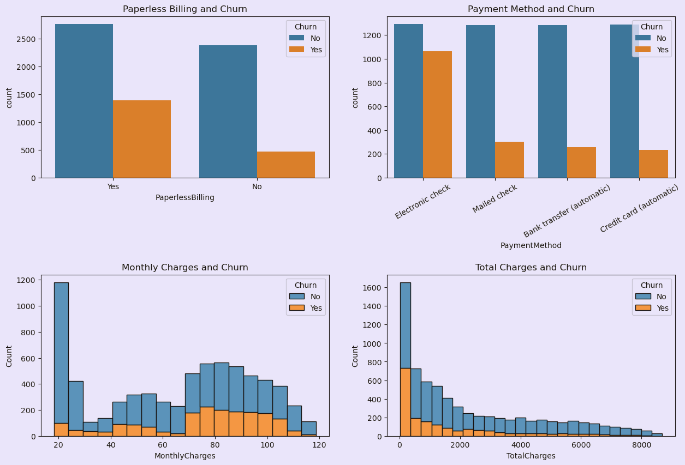
Billing/Charges and Churn:
Billing and Payment Method:
No significant relation with customer churn.
Monthly Charges:
Customers with higher monthly charges show higher churn count.
Total Charges:
Higher total charges correlate with lower churn count, likely due to long tenure or extensive service use.
Recommendation:
Lower monthly charges to reduce customer churn effectively.

Slide 14
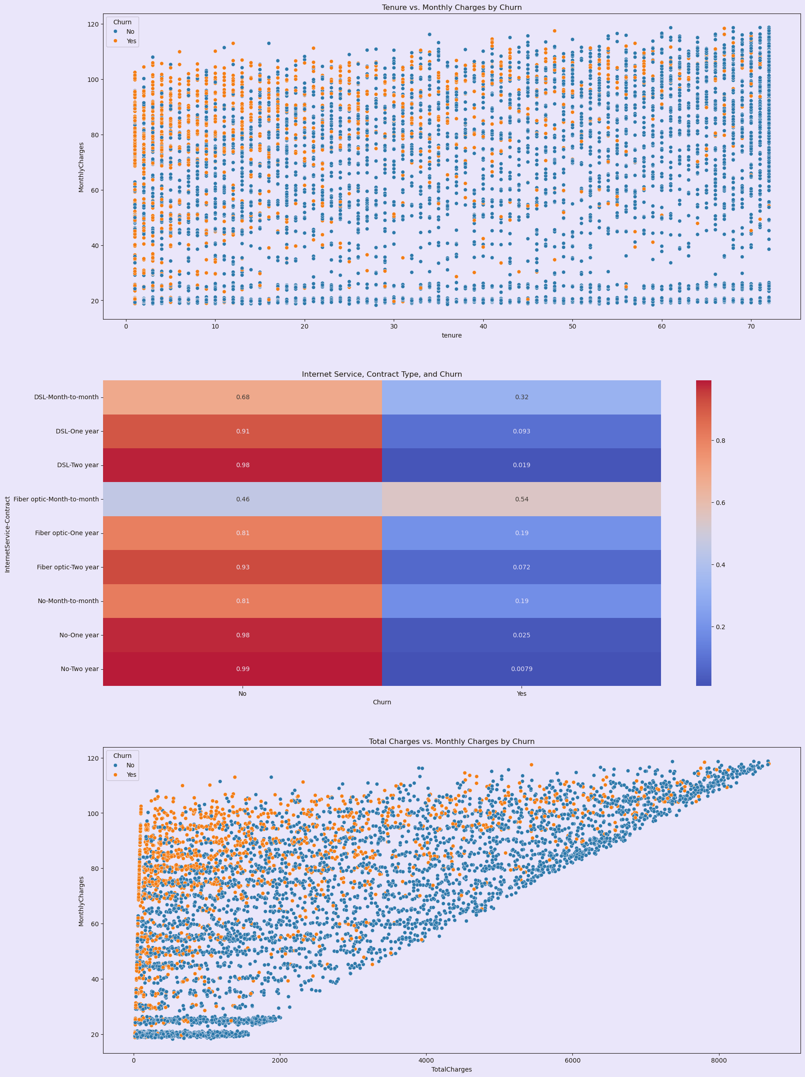
Tenure Vs. Monthly Charges by Churn
High Churn Rate:
Customers with shorter tenure and higher monthly charges show a higher churn rate (visible as more orange points in the scatter plot).
Low Churn Rate:
Customers with longer tenure and lower monthly charges exhibit a lower churn rate, suggesting they are more likely to remain with the company.

Slide 15

Total Charges vs. Monthly Charges by Churn:
High Monthly Charges:
Customers with high monthly charges have a higher churn rate.
High Total Charges:
Customers with high total charges, likely due to long tenure, have lower churn rates.
Conclusion:
Long-term customers with high total charges are more loyal, while new customers with high monthly charges are at greater risk of leaving.

Slide 16

Model Building
Balancing the Data:
Churn
0 5153
1 1857
Used SMOTE (Synthetic Minority Over-sampling Technique) to balance the dataset so the model learns better.
Machine Learning Models Used:
Decision Tree Classifier:
Splits the data into branches based on customer details.
Random Forest Classifier:
Uses multiple decision trees to improve accuracy.
K-Nearest Neighbors (KNN) Classifier:
A distance-based algorithm that predicts churn by finding similar customers in the dataset.
Logistic Regression Classifier
Probabilistic model for binary classification.
Support Vector Machine (SVM) Classifier
Finds the optimal hyperplane to separate churn vs non-churn.
XGBoost Classifier
Gradient boosting algorithm. Highly accurate and efficient for large datasets.
Hyperparameter Tuning:
Applied GridSearchCV to find the best parameters for each model, improving performance.

Slide 17
Model Evaluation
Model Performance
Model | Train Accuracy | Test Accuracy
Decision Tree | 83.48% | 76.89%
Random Forest | 87.44% | 78.53%
K-Nearest Neighbors | 89.17% | 75.18%
Logistic Regression | 80.31% | 77.38%
Support Vector Machine | 83.28% | 77.88%
XGBoost | 87.26% | 77.81%

Slide 18
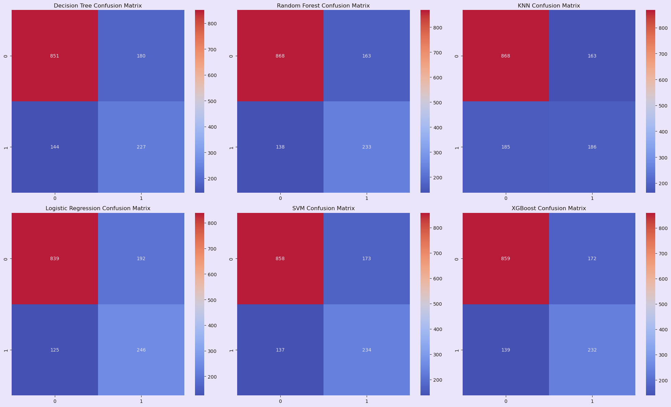
Confusion Matrix
0 1031
1 371

Slide 19
Model Ranking
Rank | Model | Accuracy | Precision (Churn=1) | Recall (Churn=1) | F1-Score (Churn=1) | Reason
🥇 1 | Random Forest | 0.785 | 0.59 | 0.63 | 0.61 | High accuracy, balanced performance
🥈 2 | XGBoost | 0.778 | 0.57 | 0.63 | 0.60 | Balanced, powerful, avoids overfitting
🥉 3 | SVM | 0.779 | 0.57 | 0.63 | 0.60 | Stable, reliable, and consistent
4 | Logistic Regression | 0.774 | 0.56 | 0.66 | 0.61 | High recall, linear model
5 | Decision Tree | 0.769 | 0.56 | 0.61 | 0.58 | Overfitting, lower overall performance
6 | KNN | 0.752 | 0.53 | 0.50 | 0.52 | Weak on class 1 (churners), poor generalization
Conclusion
Random Forest is the top performer with the best balance of accuracy and evaluation metrics.
XGBoost and SVM are strong alternatives, delivering consistent and reliable performance.
Since our primary goal is to catch more churners, Logistic Regression is a strong contender due to its highest recall, even if it sacrifices some precision.

Slide 20
Ensemble Learning – Voting Classifier
Why Use Ensemble?
Combines multiple models to improve robustness and generalization.
Handles class imbalance and captures diverse data patterns.
Boosts recall for churners (Class 1).
Model | Reason for Inclusion
Random Forest | Highest accuracy and balanced performance
XGBoost | Strong with imbalance, captures complex patterns
SVM | Reliable, great for high-dimensional space
Logistic Regression | Highest recall for churners
Performance
Training Accuracy: 84.37%
Testing Accuracy: 78.39%
Confusion Matrix:
[ 868 163
140 231 ]

Slide 21
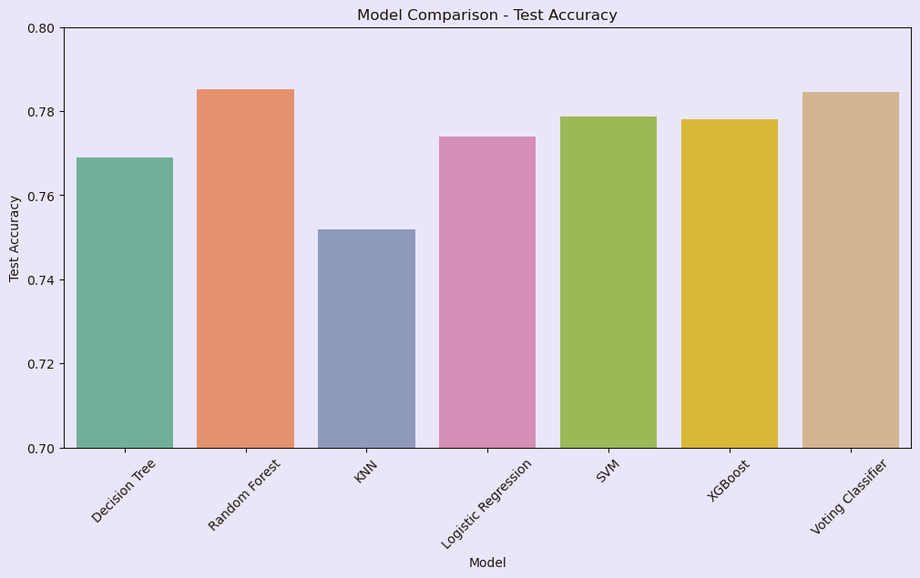
Model performance

Slide 22
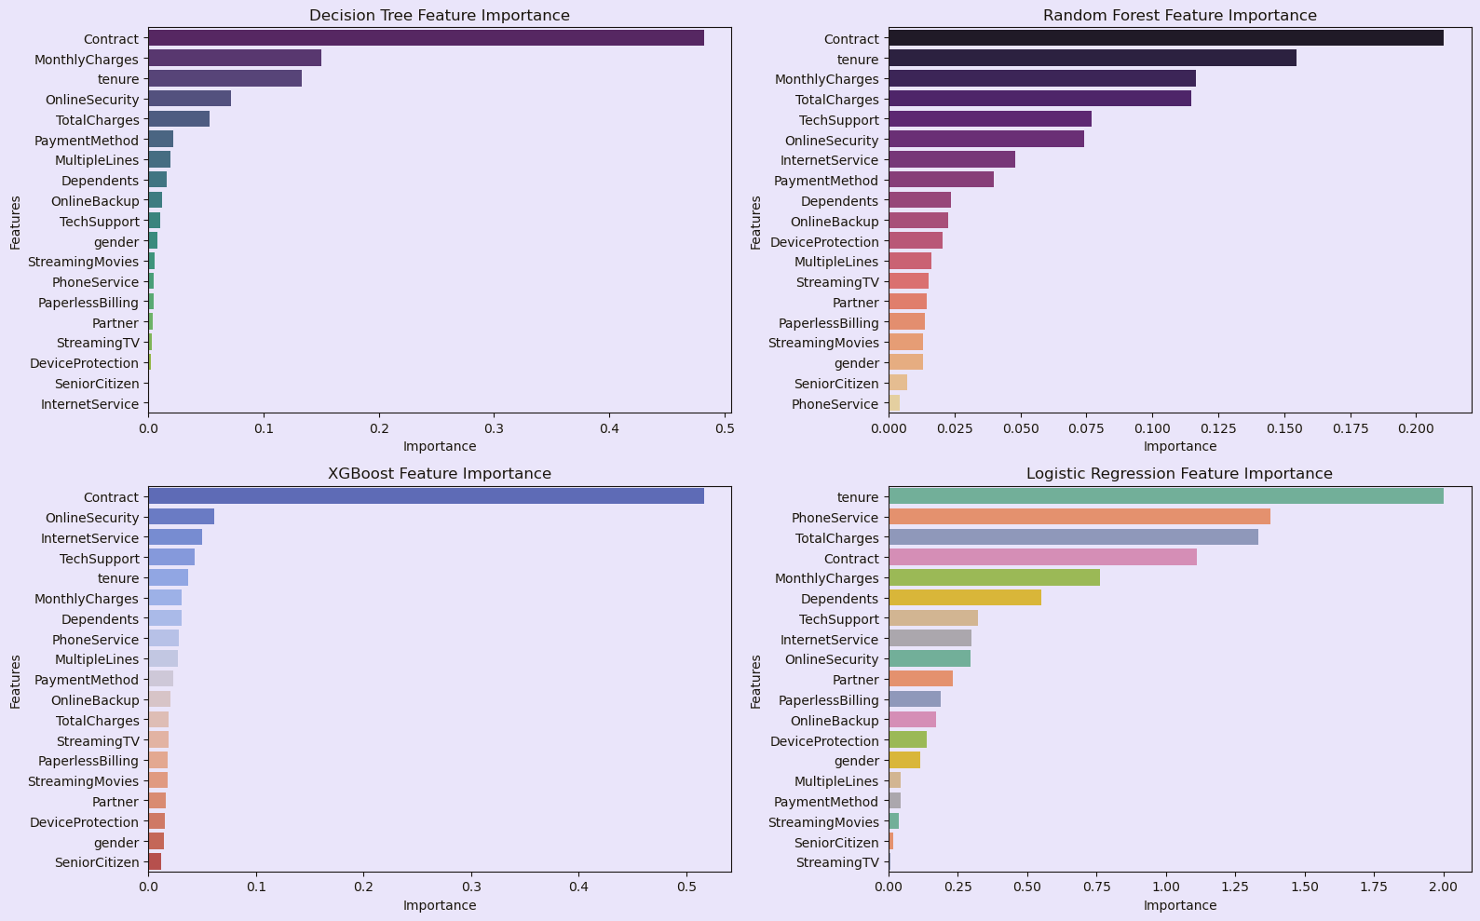
Feature Importance

Slide 23
Model Deployment
To make the churn prediction system accessible and usable, the final model was deployed using Streamlit, a powerful and lightweight Python web framework.
App Features
Churn Prediction: Input customer details and get real-time churn prediction.
Prediction Logs: View and track past predictions made through the app.
Batch Prediction: Upload CSV files to predict churn for multiple customers at once.
Model Explanation: Understand how the model makes predictions using key features.
About Page: Project overview and developer information.
Tech Stack
Frontend: Streamlit (Python)
Backend:
Voting Classifier (Ensemble of Random Forest, XGBoost, SVM, Logistic Regression)
Model Serialization: joblib used to save and load models
voting_classifier_model.joblib
random_forest_model.joblib
label_encoders_dict.joblib
standard_scaler.joblib
feature_order.joblib
Preprocessing: StandardScaler, LabelEncoder, Feature alignment
Core Libraries: Scikit-learn, XGBoost, Pandas, NumPy, Joblib

Slide 24
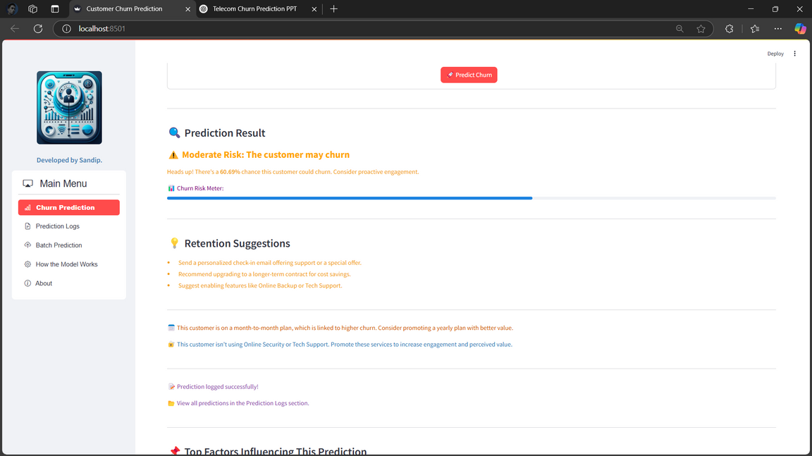
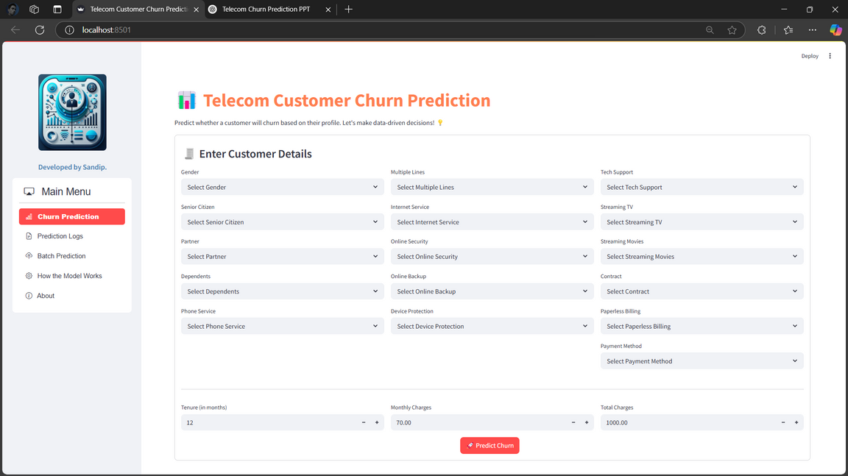
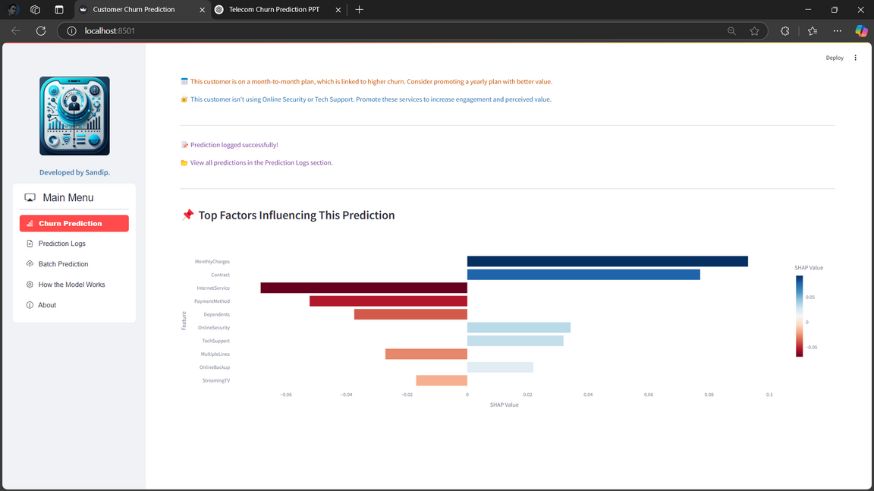
Churn Prediction
Used for real-time single-customer churn prediction.

Slide 25
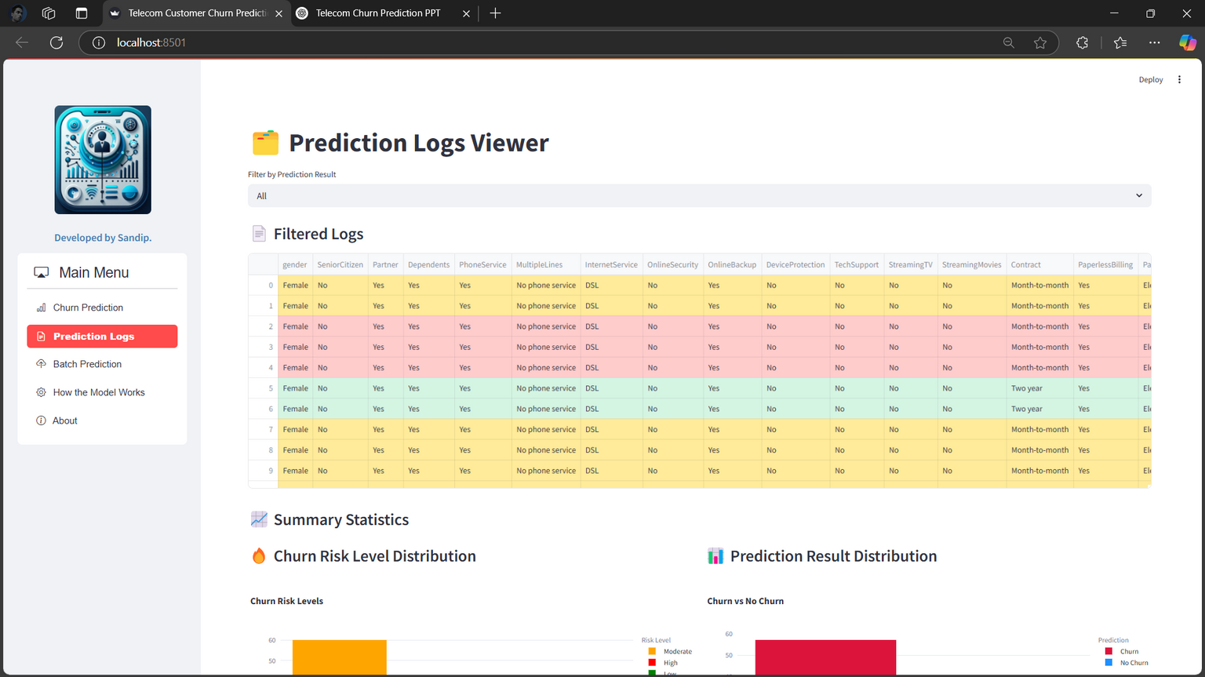
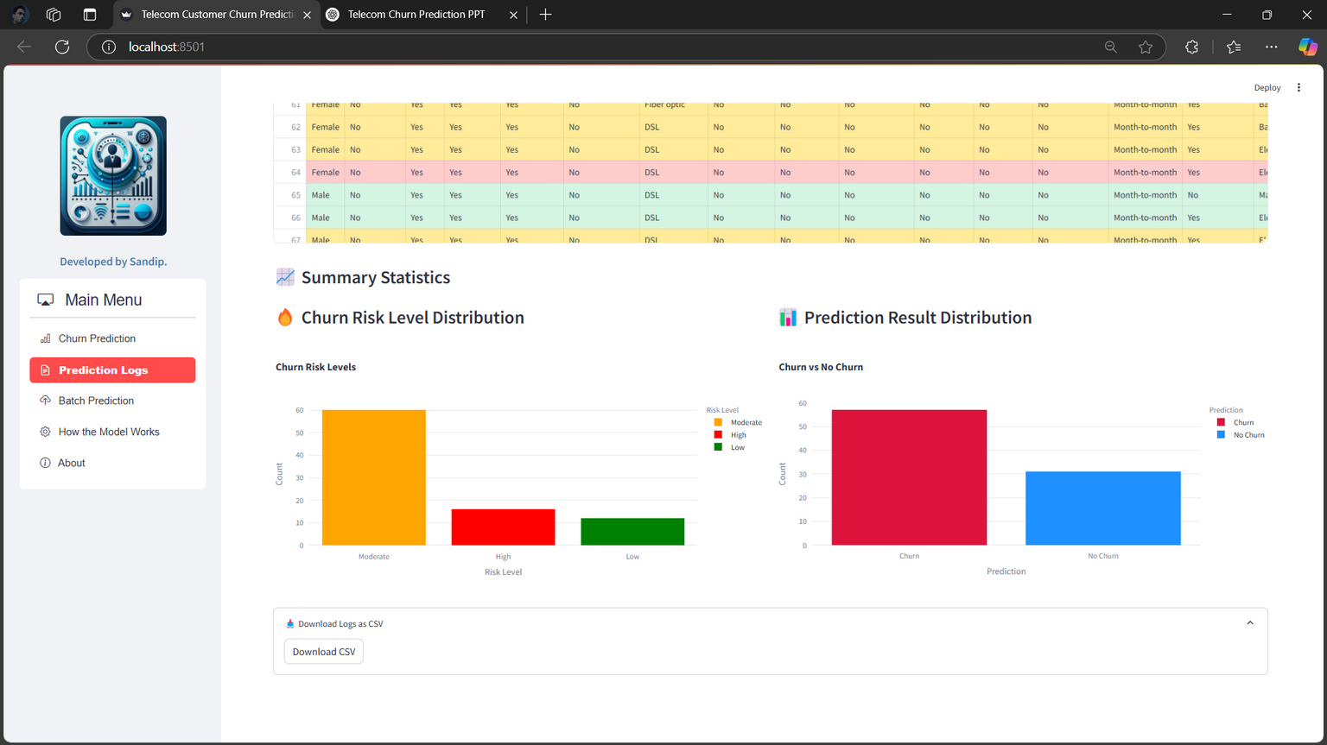
Prediction Logs
Tracks and displays historical churn predictions.

Slide 26
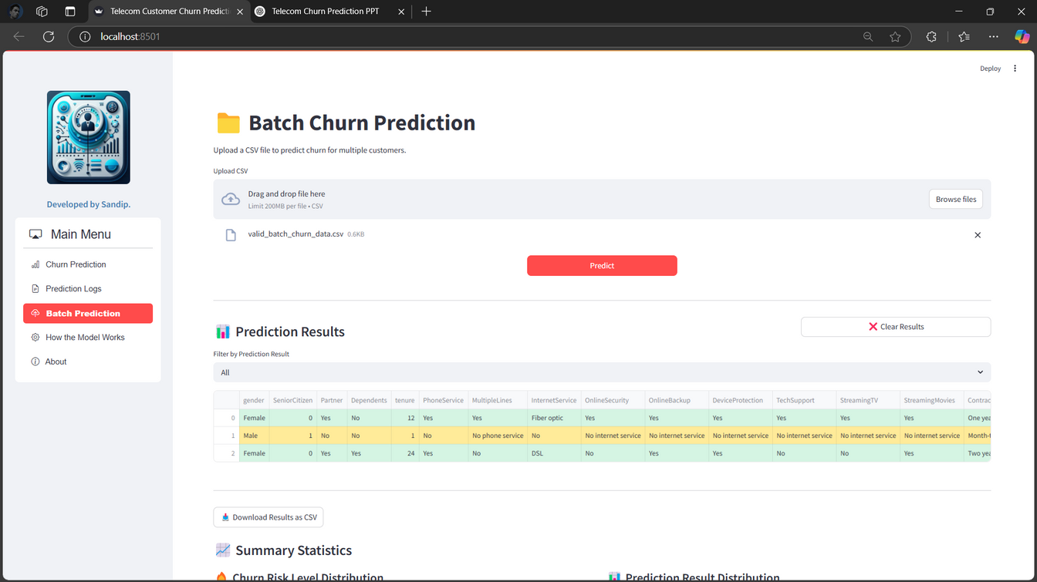
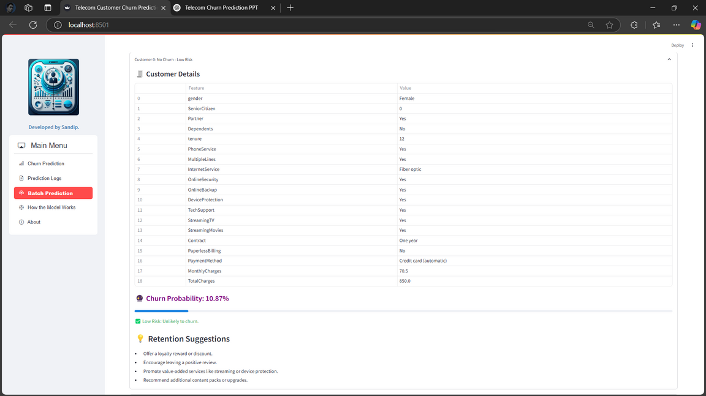
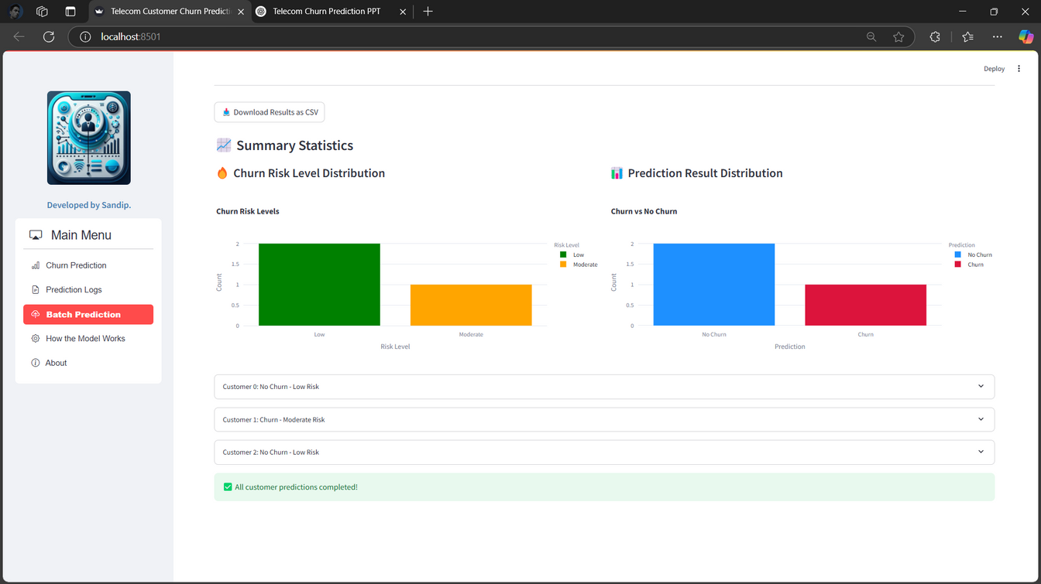
Batch Prediction
Upload customer data in bulk for batch churn prediction.

Slide 27
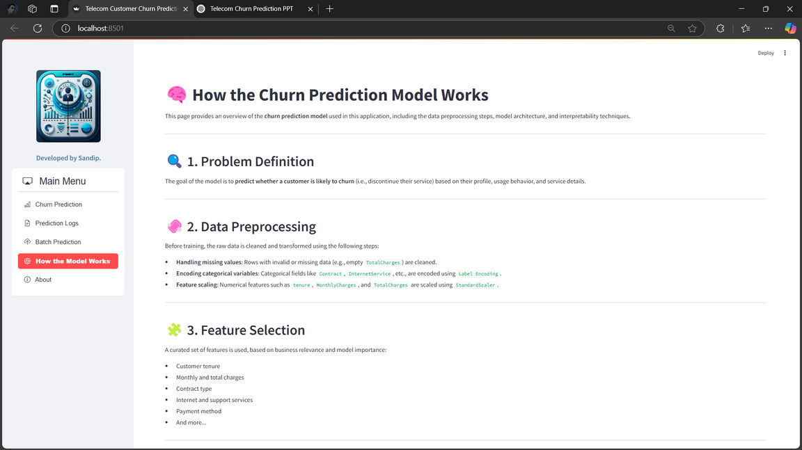
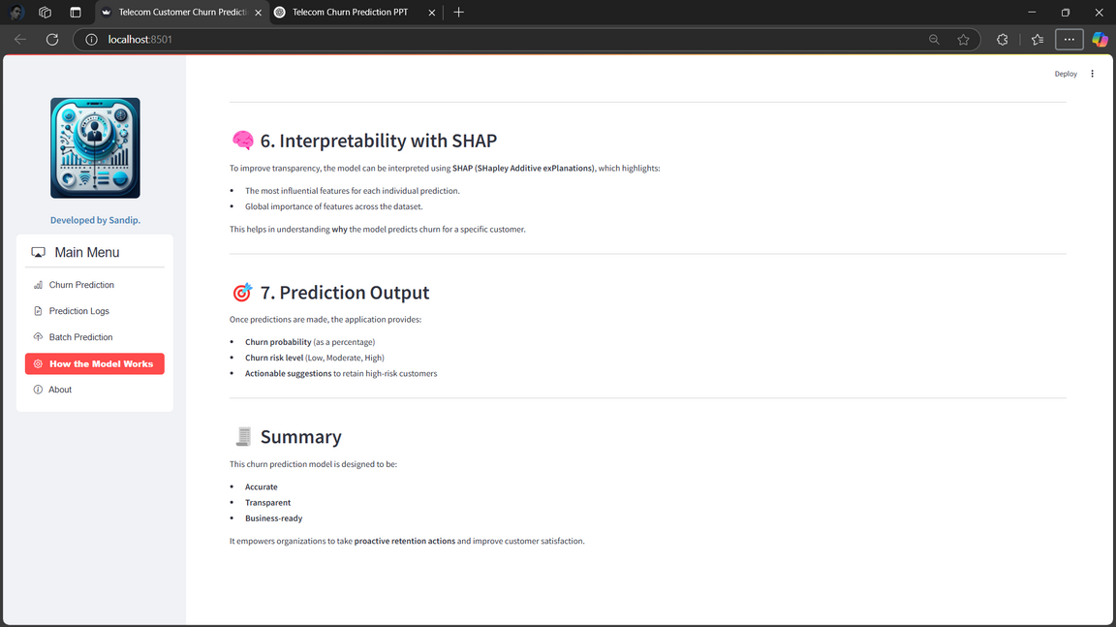
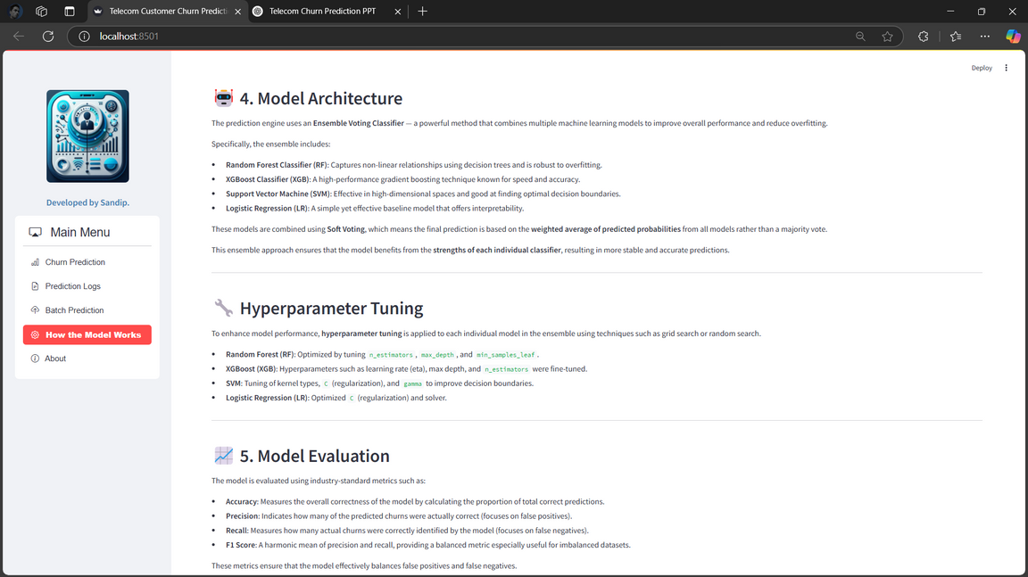
Model Explanation
Explains the ML model and important features.

Slide 28

Conclusion
Key Findings:
Customers with shorter tenure, higher monthly charges, and no tech support, Online Security, Device Protection are more likely to leave.
Customers with long-term contracts and lower monthly charges are less likely to leave.
Modeling Outcome
Multiple machine learning models were evaluated.
Random Forest delivered the best overall performance, while Logistic Regression showed the highest recall, useful for detecting churners.
An Ensemble Voting Classifier combining top models improved robustness and generalization.
A full-featured Streamlit app was deployed to enable real-time churn prediction and business usability.
Recommendations for Telecom Companies:
Offer discounts on monthly charges and long-term contracts to reduce churn.
Improve customer support and engagement to keep customers happy.
Introduce or improve value-added services (e.g., Tech support, device protection).

Slide 29
Thank
You.

